Slide 1
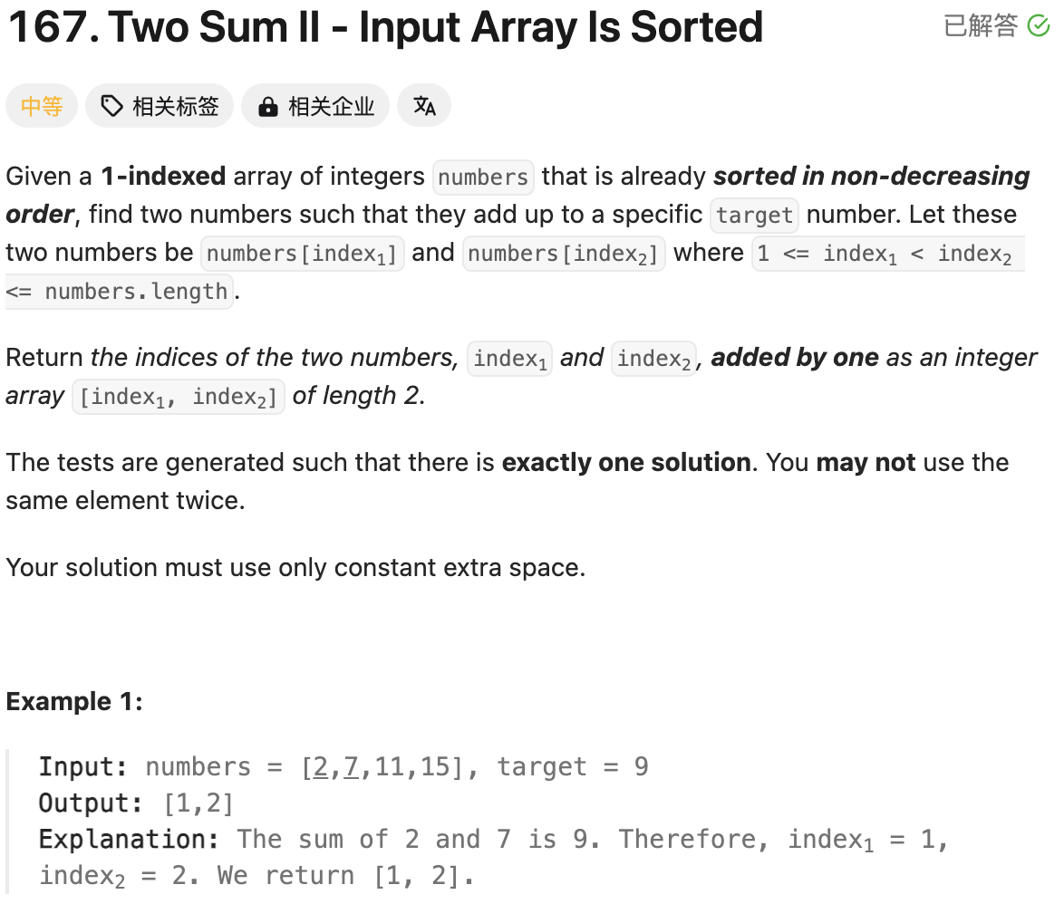
2 | 7 | 11 | 15 | 17
Bidirectional double pointer
Question tells us that it is already sorted in non-decreasing.
Brutal Force: Running time is O(n^2); Space is n
Bidirectional double pointer: Running time is O(n); Space is 1
class Solution(object):
def twoSum(self, numbers, target):
"""
:type numbers: List[int]
:type target: int
:rtype: List[int]
"""
# Double Pointers
left = 0
right = len(numbers) - 1
while left < right:
s = numbers[left] + numbers[right]
if s == target:
break
elif s < target:
left += 1
else:
right -= 1
return [left+1, right+1]
class Solution(object):
def twoSum(self, numbers, target):
"""
:type numbers: List[int]
:type target: int
:rtype: List[int]
"""
# Running Time is O(n)
# Space Complexity is O(1)
# Use the double pointers to calculate the result
# Because of sorted in non-decreasing, if sum > target, we can move the right pin; if sum < target, we can move the left pin; else, we can return result.
n = len(numbers)
right = n - 1
left = 0
while left < right:
s = numbers[left] + numbers[right]
if s > target:
right -= 1
elif s < target:
left += 1
else:
return [left + 1, right + 1]
4/28 | 4/29 | 5/2

Slide 2
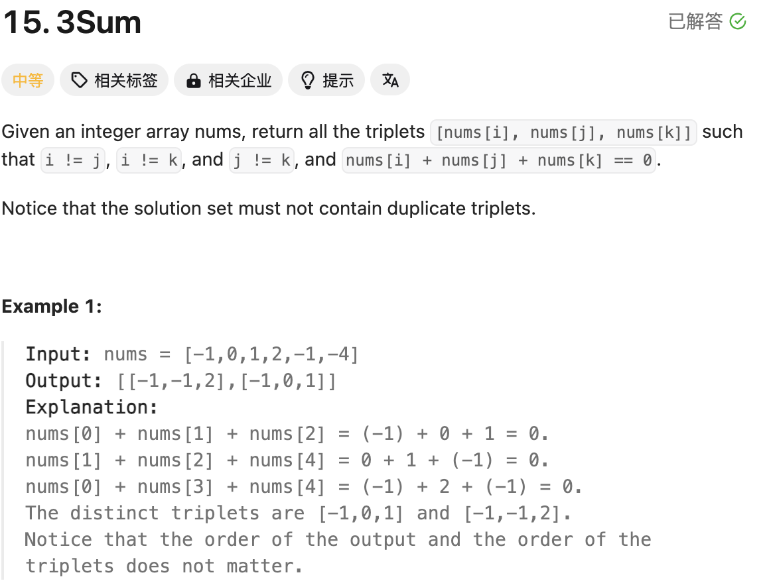
2 | 7 | 11 | 15 | 17
x + y + z = 0
X 为外侧循环指针，y 为左侧指针， z为右侧指针，同上面Two Sum思路一致
另外，Not Contain Duplicate Triplets, 需要判断x/y/z与之前是否相同
优化细节：
num[i] + num[i+1] + num[i+2] >0 break
num[i] + num[n-1] + num[n-2] <0 continue
class Solution(object):
def threeSum(self, nums):
"""
:type nums: List[int]
:rtype: List[List[int]]
"""
# Running time is O(nlogn)
nums.sort()
n = len(nums)
ans = []
# Running time is O(n^2)
# Space complexity is O(1)
for i in range(n-2):
x = nums[i]
if i > 0 and nums[i-1] == x:
continue
if x + nums[i+1] + nums[i+2] > 0:
break
if x + nums[n-1] + nums[n-2] < 0:
continue
left = i + 1
right = n - 1
while left < right:
s = x + nums[left] + nums[right]
if s > 0:
right -= 1
elif s < 0:
left += 1
else:
ans.append([x, nums[left], nums[right]])
left += 1
while left < right and nums[left] == nums[left-1]:
left += 1
right -= 1
while right > left and nums[right] == nums[right+1]:
right -= 1
return ans
class Solution(object):
def threeSum(self, nums):
"""
:type nums: List[int]
:rtype: List[List[int]]
"""
# Ruuning time nlogn for sorting
nums.sort() #The order of the output and the order of the triplets does not matter
n = len(nums)
ans = []
for i in range(n-2):
j = i + 1
k = n - 1
if i > 0 and nums[i] == nums[i-1]:
continue
if nums[i] + nums[i+1] + nums[i+2] > 0:
break
if nums[i] + nums[n-1] + nums[n-2] < 0:
continue
while j < k:
s = nums[i] + nums[j] + nums[k]
if s > 0:
k -= 1
elif s < 0:
j += 1
else:
ans.append([nums[i], nums[j], nums[k]])
j += 1
while j < k and nums[j] == nums[j-1]:
j += 1
k -= 1
while j < k and nums[k] == nums[k+1]:
k -= 1
return ans
第二遍做的时候，出现了out of index。没有考虑清楚while过程，所以需要增加条件j< k,作为限制
4/28 | 4/29 | 5/2

Slide 3
Two sum or Three sum firstly should sort and double points.
Subarray:
Subsequence:
Example:
abcdef
Subarray: abc
Subsequence: acf

Slide 4
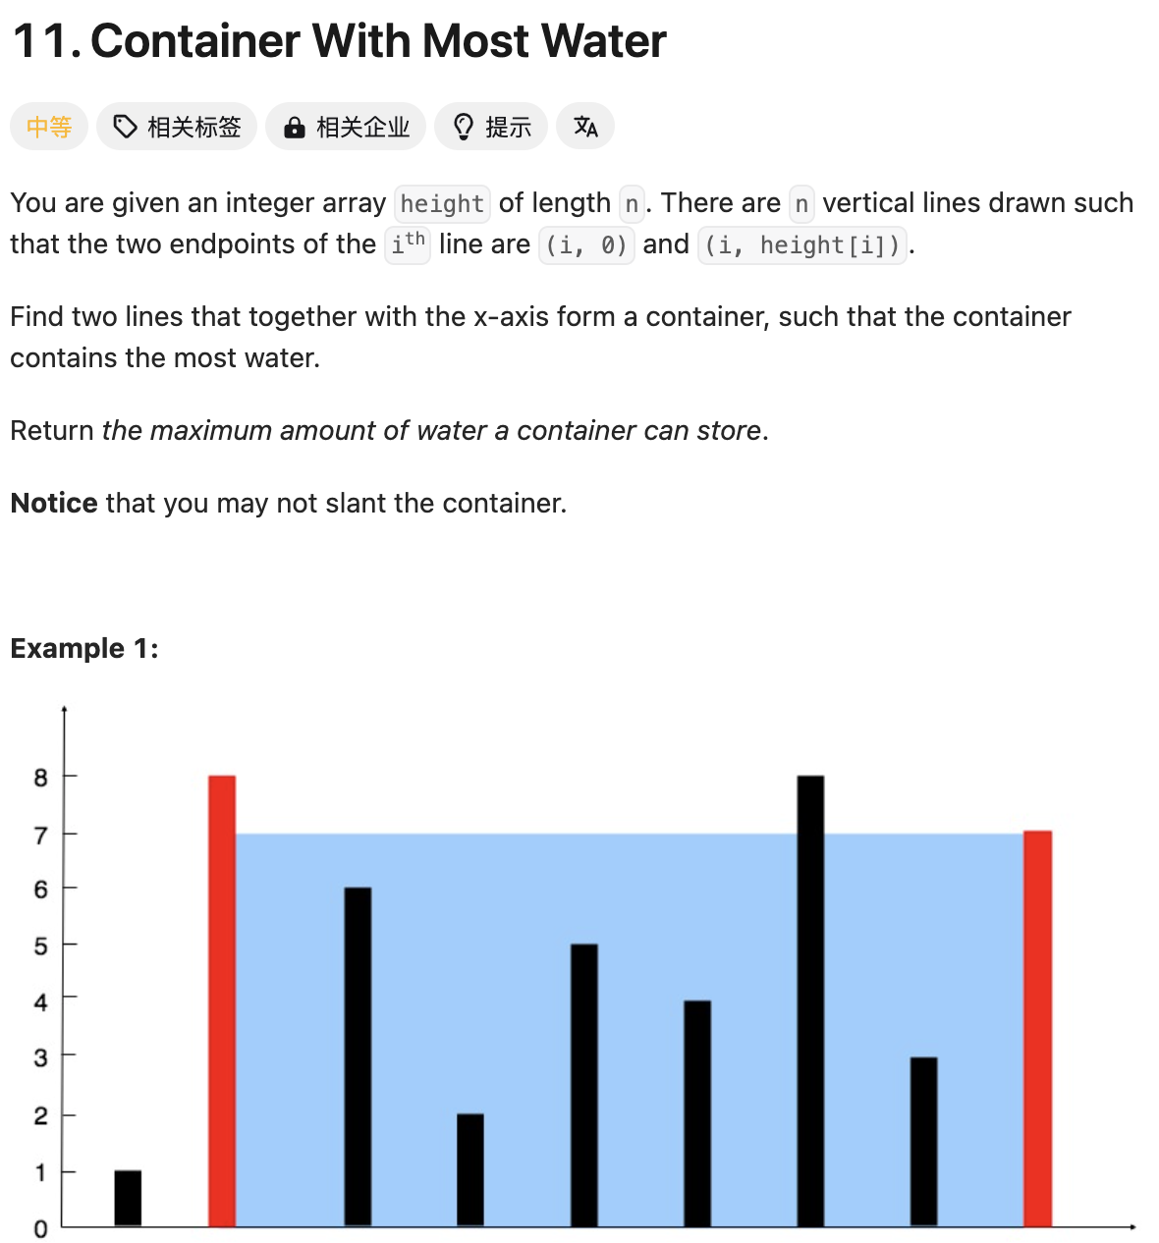
整体思路依然是双向双指针
如果左侧小于右侧，左侧指针向右侧移动一位
如果左侧大于右侧，右侧指针向左移动一位
每次对比左右两侧，最小值*宽度
Running time O(n)
Space complexity O(1)
class Solution(object):
def maxArea(self, height):
"""
:type height: List[int]
:rtype: int
"""
n = len(height)
left = 0
right = n - 1
ans = 0
while left < right:
h = min(height[left], height[right])
ans = max(ans, h * (right - left))
if height[left] < height[right]:
left += 1
else:
right -= 1
return ans
class Solution(object):
def maxArea(self, height):
"""
:type height: List[int]
:rtype: int
"""
# Double Pointer from both sides
# Running time is O(n)
# Space complexity is O(1)
n = len(height)
left = 0
right = n - 1
ans = 0
while left < right:
min_height = min(height[left], height[right])
ans = max(ans, min_height * (right - left))
# Add condition to move left or right pin
if height[left] < height[right]:
left += 1
else:
right -= 1
return ans
4/28 | 4/29 | 5/2

Slide 5
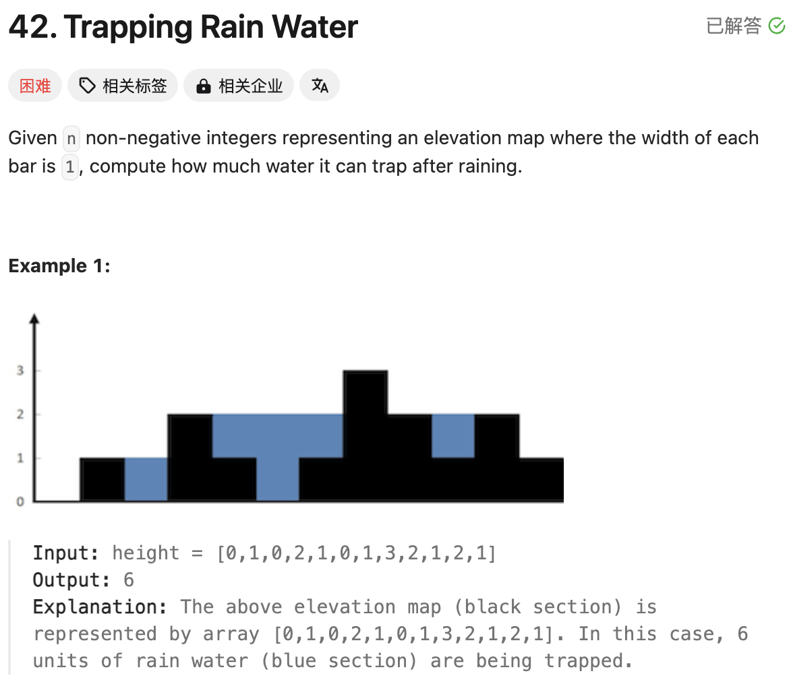
Pre-max 和Suf_max分别为前序和后续，遍历求出不同梯度的最大高度
在Pre-max 和Suf_max中取最小值，并与height进行计算
class Solution(object):
def trap(self, height):
"""
:type height: List[int]
:rtype: int
"""
n = len(height)
pre_height = [0] * n
pre_height[0] = height[0]
suf_height = [0] * n
suf_height[n-1] = height[n-1]
for i in range(1, n):
pre_height[i] = max(pre_height[i-1], height[i])
for i in range(n-2, -1, -1):
suf_height[i] = max(suf_height[i+1], height[i])
ans = 0
for i in range(n):
ans += min(pre_height[i], suf_height[i]) - height[i]
return ans
class Solution(object):
def trap(self, height):
"""
:type height: List[int]
:rtype: int
""" # Pre_max and suf_max calculate the height: So Important
# Running time is O(n)
# Space complexity is O(1)
n = len(height)
ans = 0
pre_max = [0] * n
pre_max[0] = height[0]
for i in range(1, n):
pre_max[i] = max(pre_max[i-1], height[i])
suf_max = [0] * n
suf_max[-1] = height[-1]
for i in range(n-2, -1, -1):
suf_max[i] = max(suf_max[i+1], height[i])
for i in range(n):
min_height = min(pre_max[i], suf_max[i])
ans += min_height - height[i]
return ans
4/28 | 4/29 | 5/2

Slide 6
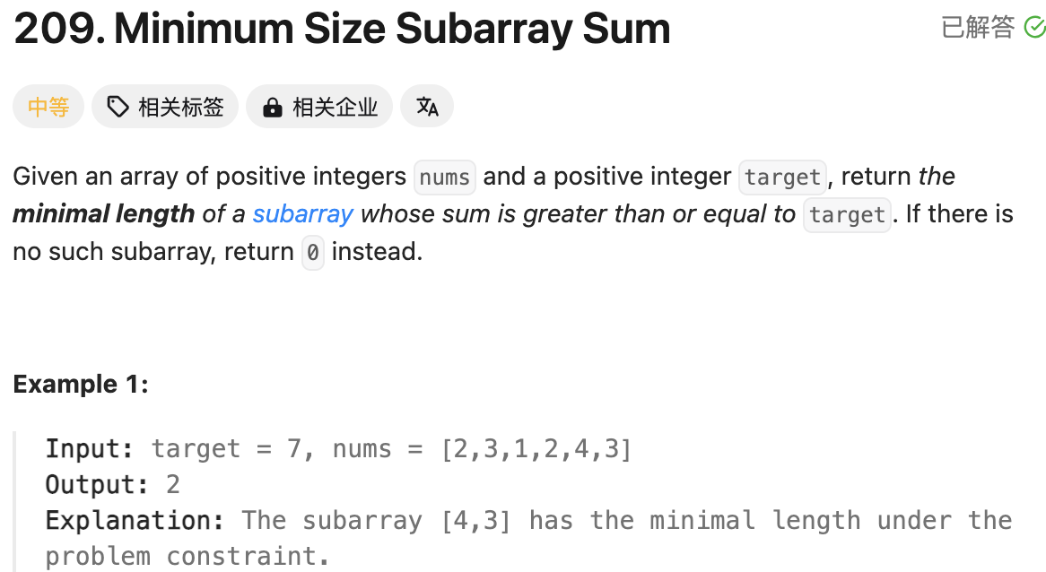
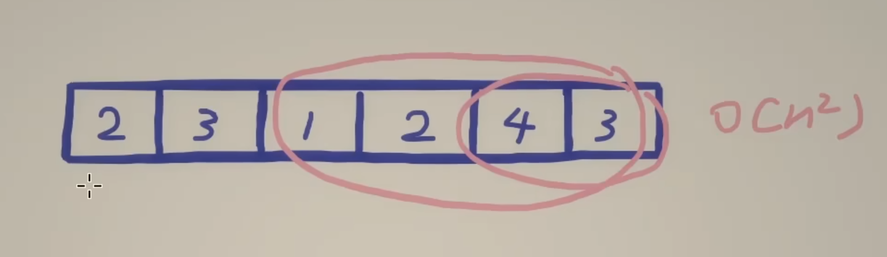
一个指针sum连续数字的和
另一个指针为慢指针，让sum的值减去left side value， 如果sum- num[left] > target，这一步实现使用while
同时接收最小的length。
注意right – left + 1
class Solution(object):
def minSubArrayLen(self, target, nums):
"""
:type target: int
:type nums: List[int]
:rtype: int
"""
# Running time is O(n)
# Space is O(1)
# while s - nums[left] >= target:
# s -= nums[left]
# left += 1
# I considered how to correctly move left pointer
n = len(nums)
ans = n + 1
s = 0
left = 0
for i in range(n):
s += nums[i]
while s - nums[left] >= target:
s -= nums[left]
left += 1
if s >= target:
ans = min(ans, i - left + 1)
return ans if ans < n + 1 else 0
4/28 | 4/29 | 5/2

Slide 7
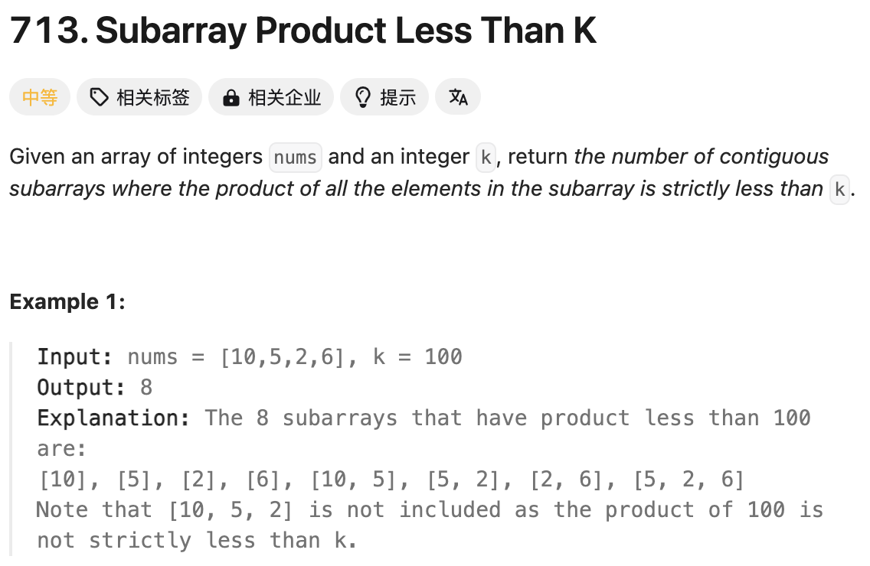
一个指针sum连续数字的乘机
另一个指针为慢指针，让sum的值除去left side value， 如果sum > target，这一步实现使用while
ans = right – left + 1
class Solution(object):
def numSubarrayProductLessThanK(self, nums, k):
"""
:type nums: List[int]
:type k: int
:rtype: int
"""
# Running time is O(n)
# Space is O(1)
# while left < n, border is so important.
if k <= 1:
return 0
n = len(nums)
ans = 0
left = 0
s = 1
for i in range(n):
s *= nums[i]
while left < n and s >= k:
s /= nums[left]
left += 1
if s < k:
ans += i - left + 1
return ans
4/28 | 4/29 | 5/2

Slide 8
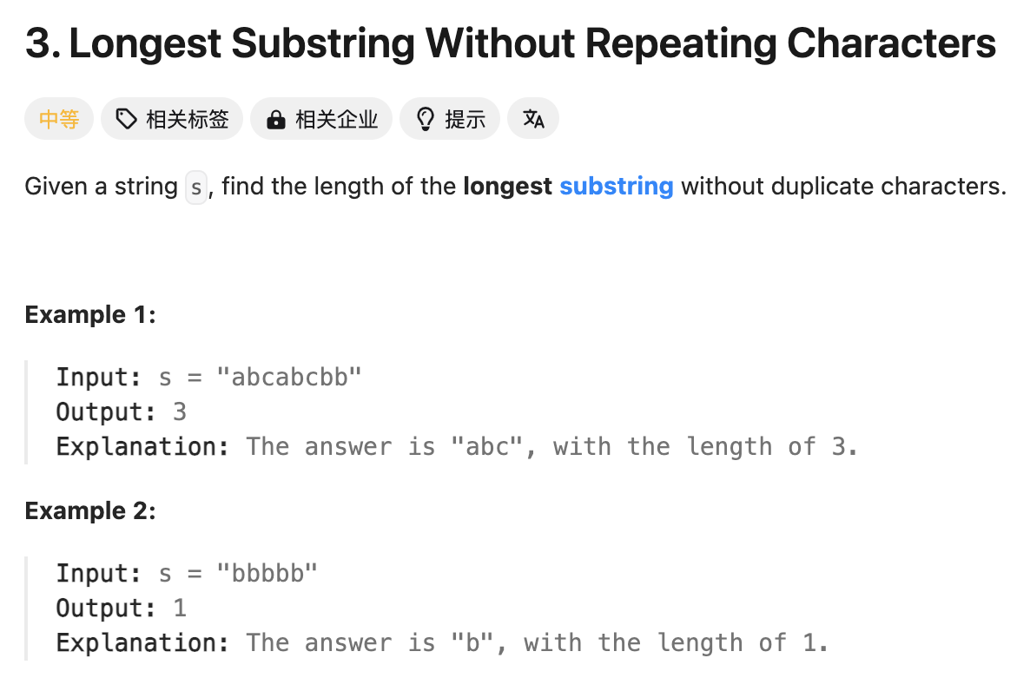
特别需要注意的是hashmap减去的是left side的频次
class Solution(object):
def lengthOfLongestSubstring(self, s):
"""
:type s: str
:rtype: int
"""
# Hashmap
cnt = Counter() # char int
left = 0
ans = 0
for i, x in enumerate(s):
cnt[x] += 1
while left <= i and cnt[x] > 1:
cnt[s[left]] -= 1
left += 1
ans = max(ans, i - left + 1)
return ans

Slide 9
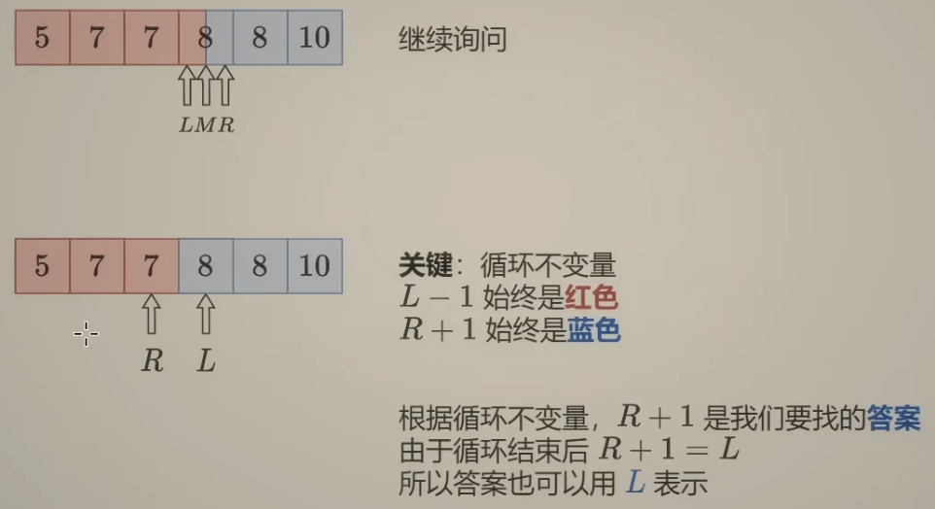
# Binary search for the second version
def lower_bound(nums, target):
n = len(nums)
l = 0
r = n-1
while l <= r:
mid = l + (r - l) //2
if nums[mid] < target:
l = mid + 1
else:
r = mid - 1
return l
l = lower_bound(nums, target)
r = lower_bound(nums, target+1) - 1
if l < len(nums) and nums[l] == target:
return [l, r]
else:
return [-1, -1]
def find_left(nums, target):
left, right = 0, len(nums) - 1
res = -1
while left <= right:
mid = (left + right) // 2
if nums[mid] < target:
left = mid + 1
else:
if nums[mid] == target:
res = mid
right = mid - 1 # keep going left
return res
from bisect import bisect_left, bisect_right
def searchRange(nums, target):
left = bisect_left(nums, target)
right = bisect_right(nums, target) - 1 # bisect_right gives one past the last position
if left <= right and left < len(nums) and nums[left] == target and nums[right] == target:
return [left, right]
else:
return [-1, -1]
def find_right(nums, target):
left, right = 0, len(nums) - 1
res = -1
while left <= right:
mid = (left + right) // 2
if nums[mid] > target:
right = mid - 1
else:
if nums[mid] == target:
res = mid
left = mid + 1 # keep going right
return res
建议写左闭右闭
l = 0
r = n-1
While l <= r
l = mid + 1
r = mid -1

Slide 10
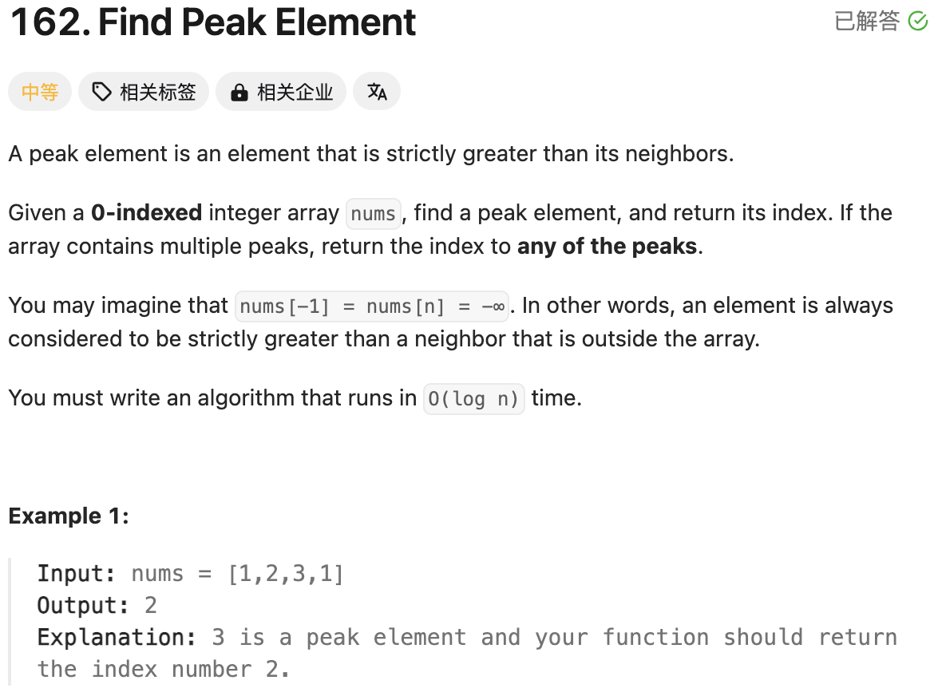
关键点是升序排列，所以num[n] < num[n+1]
class Solution(object):
def findPeakElement(self, nums):
"""
:type nums: List[int]
:rtype: int
"""
n = len(nums)
l = 0
r = n-2
while l <= r:
mid = (l + r) // 2
if nums[mid] < nums[mid+1]:
l = mid + 1
else:
r = mid - 1
return l

Slide 11
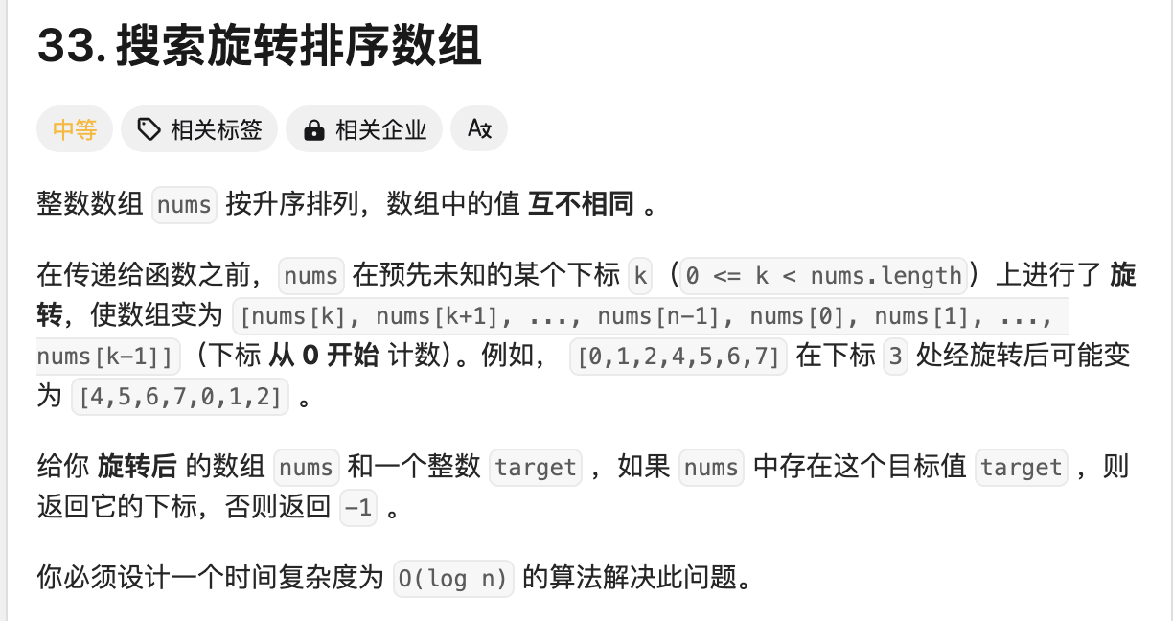

Slide 12
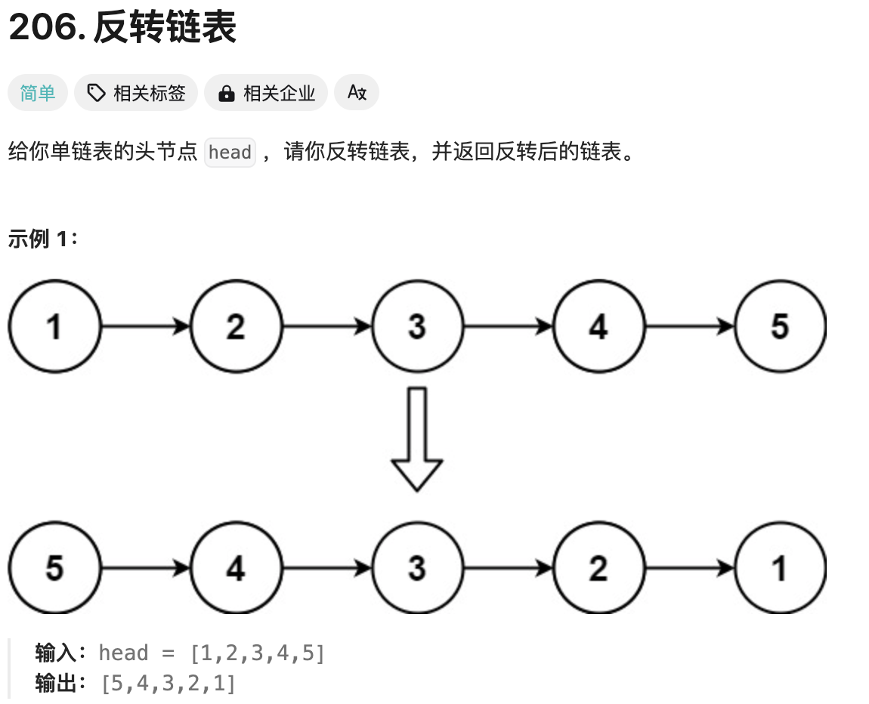
# Definition for singly-linked list.
# class ListNode(object):
# def __init__(self, val=0, next=None):
# self.val = val
# self.next = next
class Solution(object):
def reverseList(self, head):
"""
:type head: Optional[ListNode]
:rtype: Optional[ListNode]
"""
pre = None
cur = head
while cur:
nxt = cur.next
cur.next = pre
pre = cur
cur = nxt
return pre

Slide 13
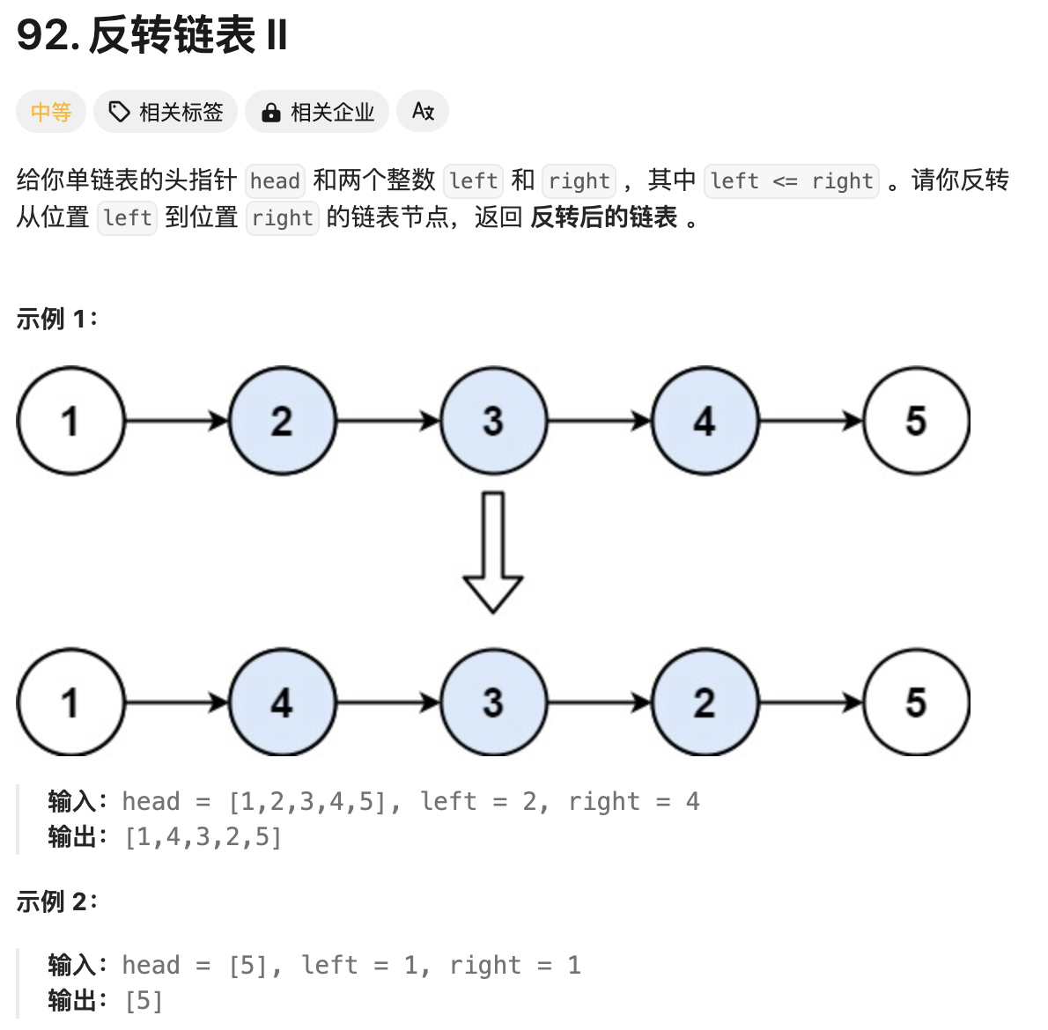
旋转链表的基本概念需要掌握
pre = None
cur = head
while cur:
nxt = cur.next
cur.next = pre
pre = cur
cur = nxt
return pre
# Definition for singly-linked list.
# class ListNode(object):
# def __init__(self, val=0, next=None):
# self.val = val
# self.next = next
class Solution(object):
def reverseBetween(self, head, left, right):
"""
:type head: Optional[ListNode]
:type left: int
:type right: int
:rtype: Optional[ListNode]
"""
dummy = ListNode(next=head)
p0 = dummy
for _ in range(left-1):
p0 = p0.next
pre = None
cur = p0.next
for _ in range(right - left + 1):
nxt = cur.next
cur.next = pre
pre = cur
cur = nxt
p0.next.next = cur
p0.next = pre
return dummy.next

Slide 14
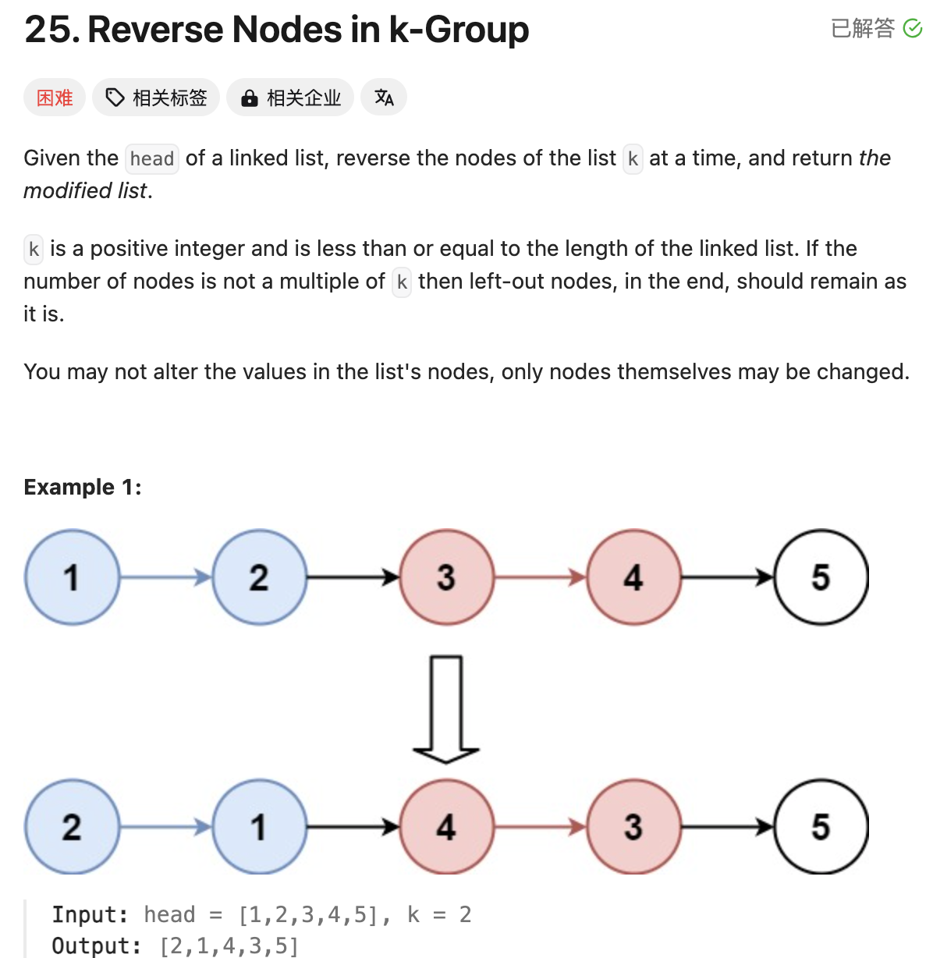
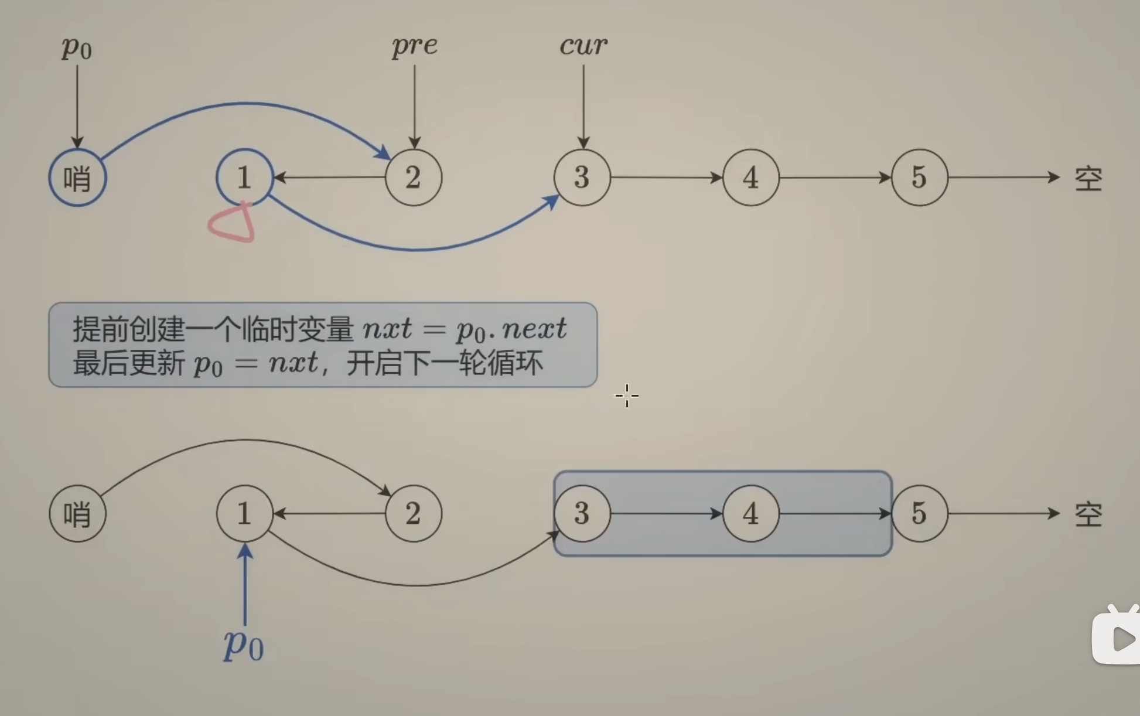
# Definition for singly-linked list.
# class ListNode(object):
# def __init__(self, val=0, next=None):
# self.val = val
# self.next = next
class Solution(object):
def reverseKGroup(self, head, k):
"""
:type head: Optional[ListNode]
:type k: int
:rtype: Optional[ListNode]
"""
# Calculate the length of Linklist
n = 0
cur = head
while cur:
n += 1
cur = cur.next
dummy = ListNode(next=head)
p0 = dummy
while n >= k:
n -= k
cur = p0.next
pre = None
for _ in range(k):
nxt = cur.next
cur.next = pre
pre = cur
cur = nxt
temp = p0.next
p0.next.next = cur
p0.next = pre
p0 = temp
return dummy.next

Slide 15
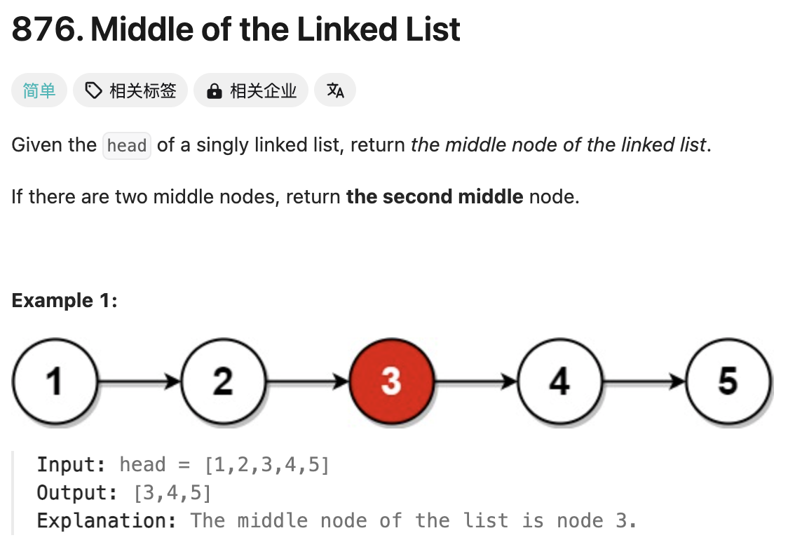
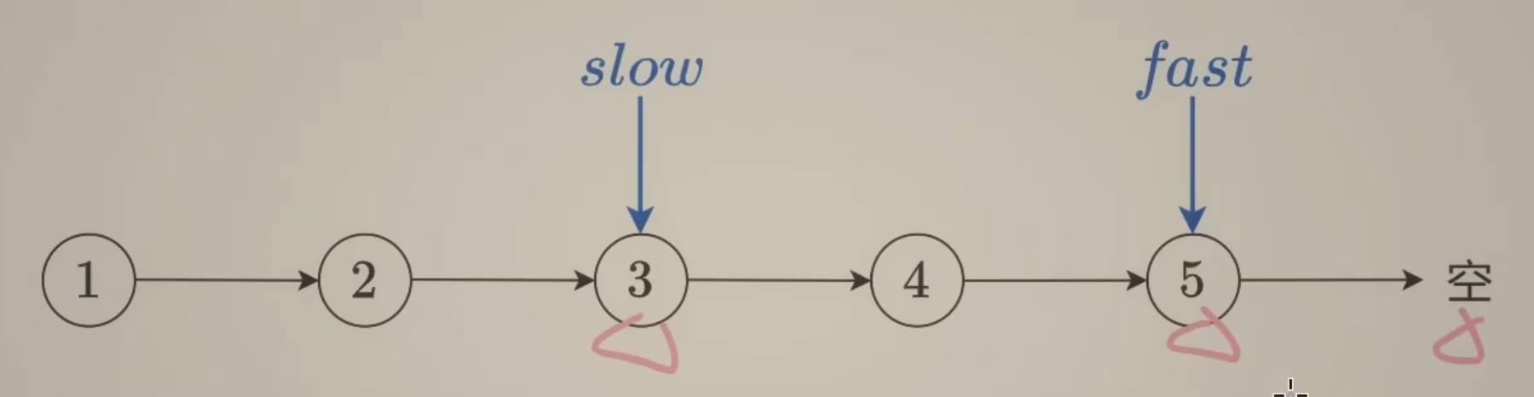
快慢指针能够快速寻Middle of the Linked List
# Definition for singly-linked list.
# class ListNode(object):
# def __init__(self, val=0, next=None):
# self.val = val
# self.next = next
class Solution(object):
def middleNode(self, head):
"""
:type head: Optional[ListNode]
:rtype: Optional[ListNode]
"""
# Slow and Fast Pointer:
# Slow moves 1 step; Fast moves 2 step per 1 time
slow = head
fast = head
while fast and fast.next:
slow = slow.next
fast = fast.next.next
return slow

Slide 16
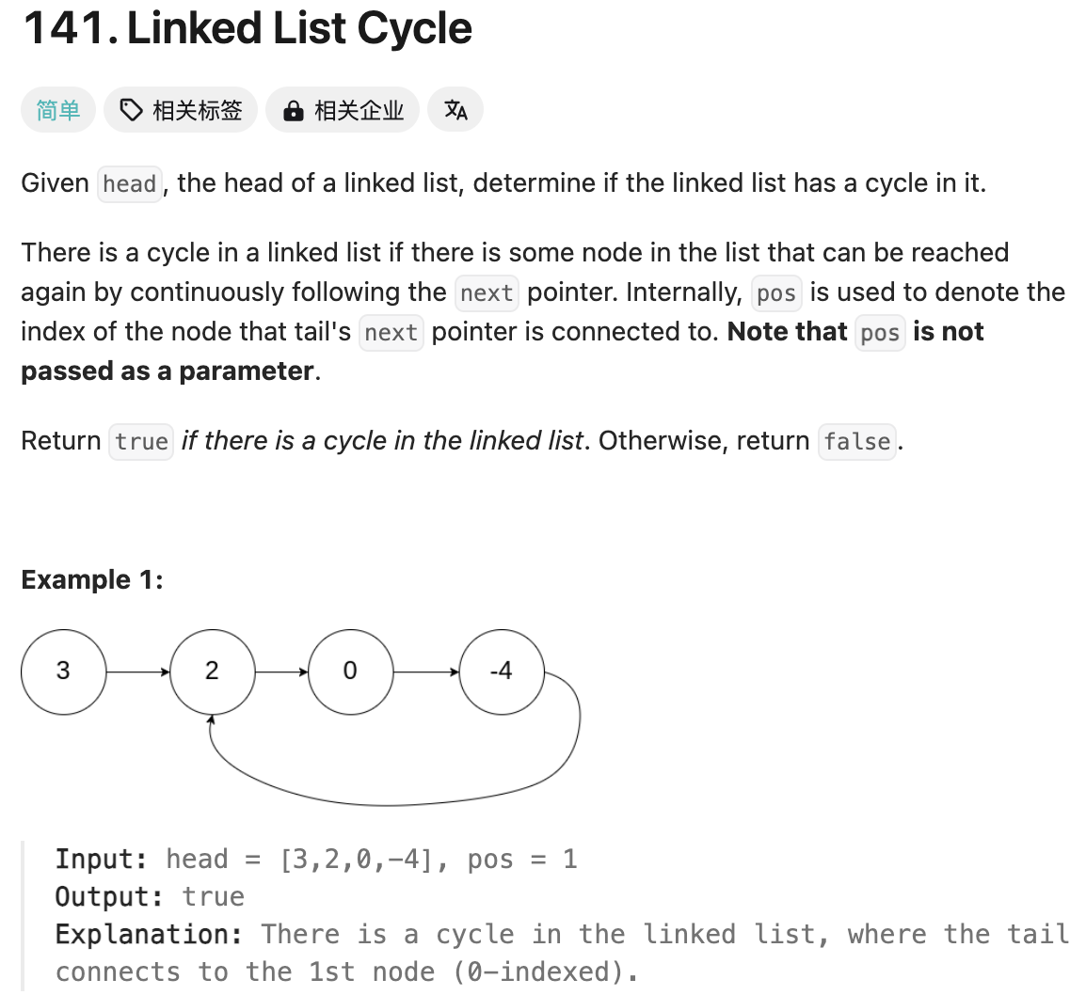
快慢指针应用，如果快速能够遇到慢指针，代表存在环
# Definition for singly-linked list.
# class ListNode(object):
# def __init__(self, x):
# self.val = x
# self.next = None
class Solution(object):
def hasCycle(self, head):
"""
:type head: ListNode
:rtype: bool
"""
fast = head
slow = head
while fast and fast.next:
fast = fast.next.next
slow = slow.next
if fast is slow:
return True
return False

Slide 17
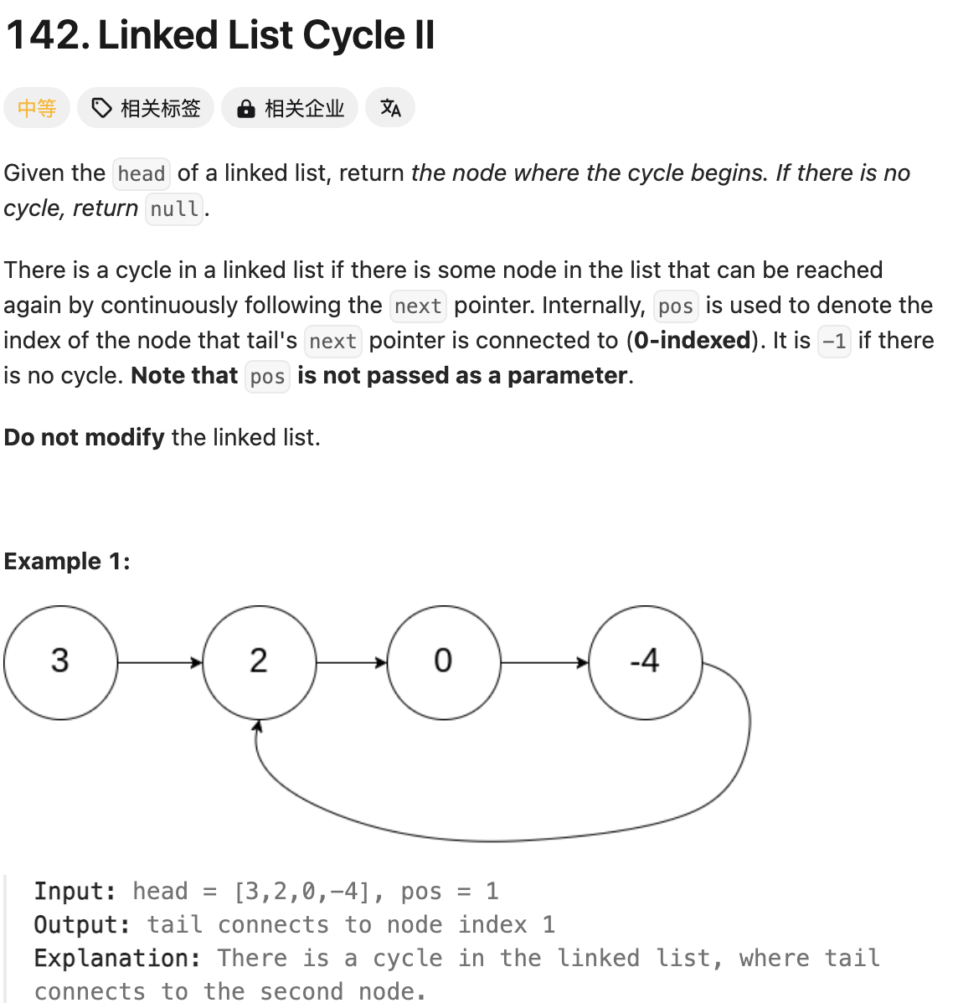
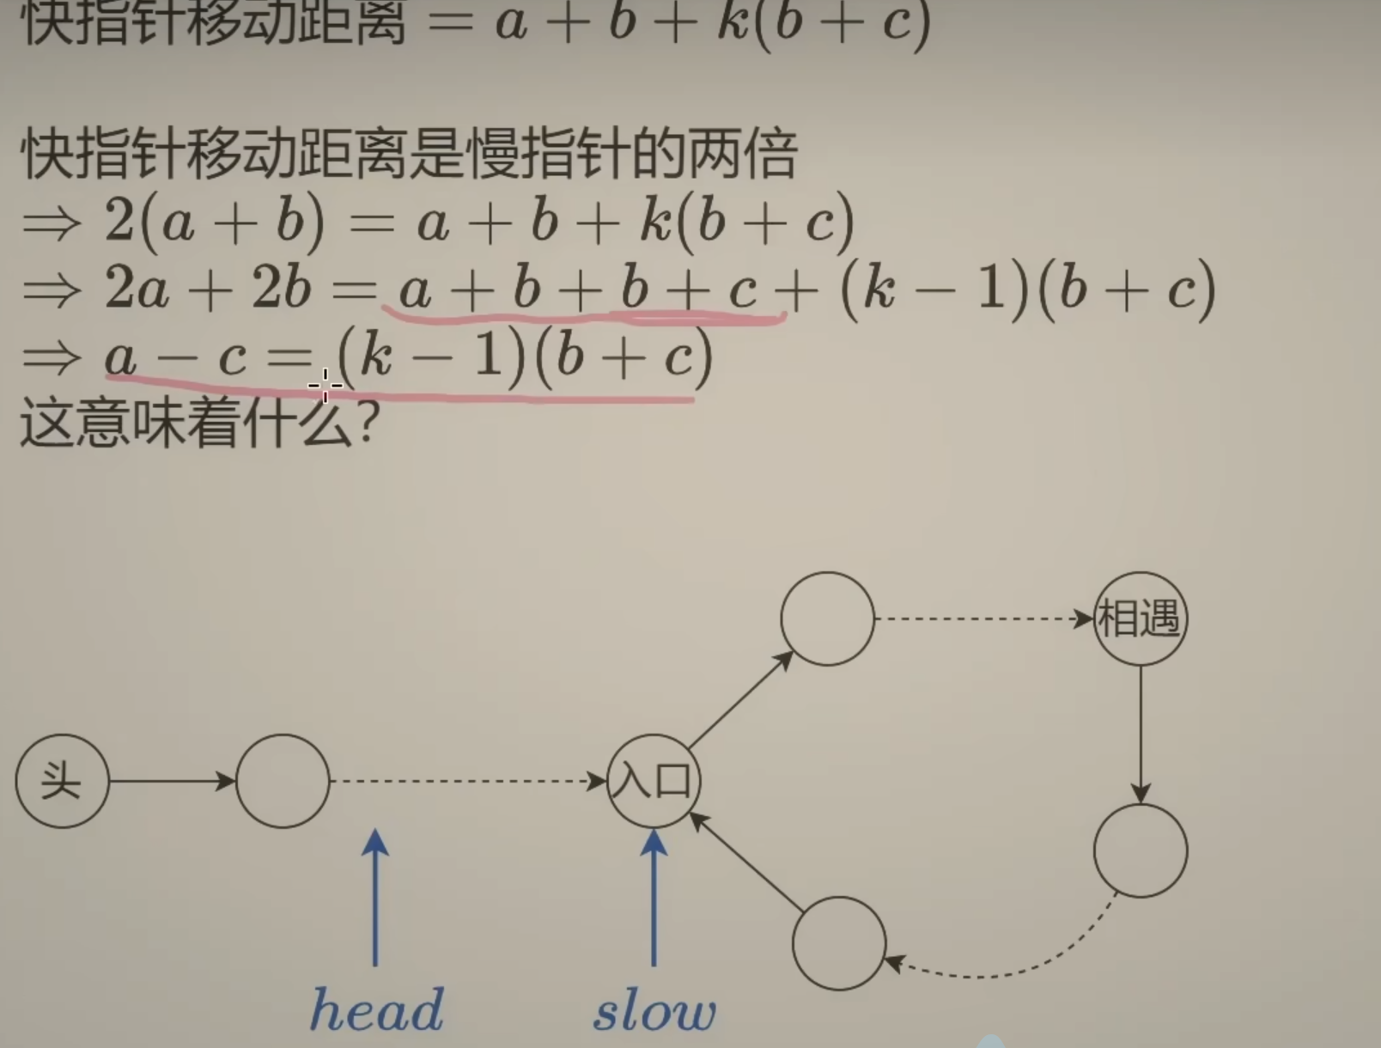
# Definition for singly-linked list.
# class ListNode(object):
# def __init__(self, x):
# self.val = x
# self.next = None
class Solution(object):
def detectCycle(self, head):
"""
:type head: ListNode
:rtype: ListNode
"""
fast = head
slow = head
while fast and fast.next:
fast = fast.next.next
slow = slow.next
if fast is slow:
while slow is not head:
slow = slow.next
head = head.next
return slow
return None

Slide 18
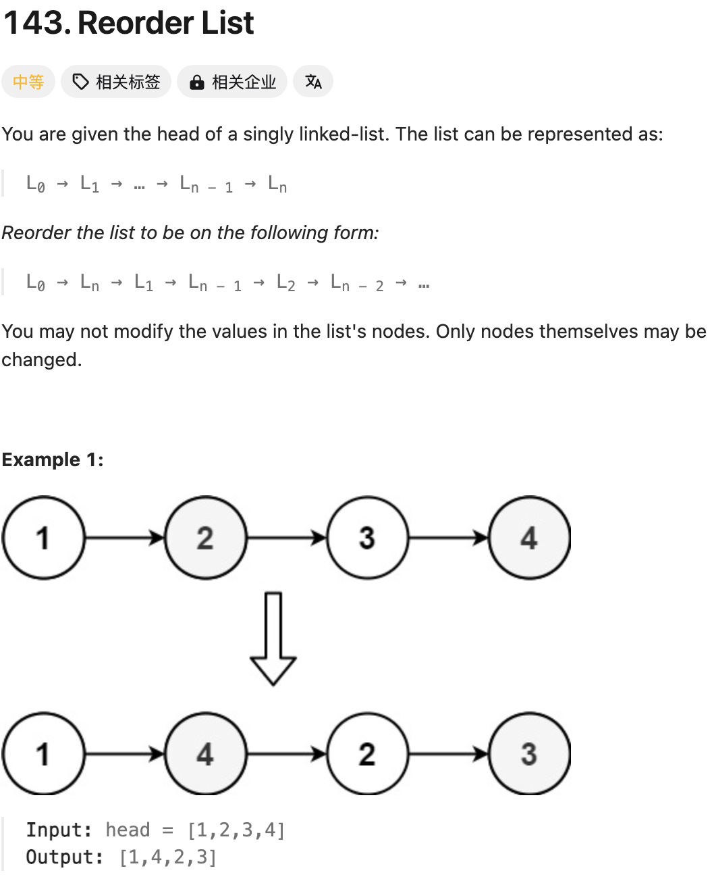
# Definition for singly-linked list.
# class ListNode(object):
# def __init__(self, val=0, next=None):
# self.val = val
# self.next = next
class Solution(object):
def reorderList(self, head):
"""
:type head: Optional[ListNode]
:rtype: None Do not return anything, modify head in-place instead.
"""
# Find the middle index
def find_mid(head):
fast = head
slow = head
while fast and fast.next:
fast = fast.next.next
slow = slow.next
return slow
# Reverse the Linklist
def reverse_linklist(head):
pre = None
cur = head
while cur:
nxt = cur.next
cur.next = pre
pre = cur
cur = nxt
return pre
mid = find_mid(head)
head2 = reverse_linklist(mid)
while head2.next:
h1 = head.next
h2 = head2.next
head.next = head2
head2.next = h1
head2 = h2
head = h1

